Slide 1
Molecular Biology Biol 480
Lecture 2 January 11, 2019

Slide 2
Announcements/Assignments
Look for lab documents for next week’s lab on the website. I will upload sometime this afternoon or evening.
Lab 1—Bacterial transformation---DNA is the genetic material/gene expression regulation

Slide 3
Let’s talk a little about DNA origami. What’s that about?
Chapter 10 introduces us to the first observations of DNA as the genetic material.
In what ways was DNA shown to be a “tough” durable chemical?
Why, was DNA thought to be too simple a molecule to be the genetic material? Why was protein a more likely candidate?
In nature/applications is simple better?
What makes DNA a “ sticky” molecule?

Slide 4
Why is the term “origami” used in the news article? Can you see a drawback to using the term? Think about science in the news—is it done well?
Did you notice that the technology has been made available to anyone? Is this the norm? Should it be open access?

Slide 5
Where were we…
What’s Molecular Biology all about?
What’s a small molecule? Large/macromolecule?
What’s the most abundant molecule in cells?
Use the analogy “recipe” to describe DNA/genes

Slide 6
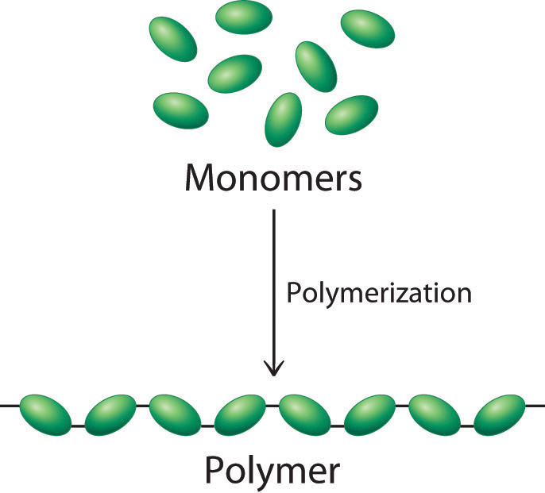
All the macromolecules of cells have a common construction---they are polymers of small molecules.

Slide 7
polymers
All 4 classes of macromolecules (Protein, Nucleic acids, Lipids, polysaccharides) are considered polymers---large molecules built of small subunits (monomers)
Proteins from amino acids (20 kinds)
Nucleic acids from nucleotides (5 kinds)
Polysaccahrides from sugars
Lipids from fatty acids and glycerol

Slide 8
What features do macromolecules share?
Polymers
Made from a limited number of different types of subunits
Synthesis utilizes a common chemical reaction (dehydration/condensation)
Versatility / variability in the structure and function of these molecules is related to:
Length of the polymer
Variability in the sequence of the subunits

Slide 9
For example…
Nucleic acids (DNA and RNA) each built from only 4 different subunits. While the sequence of DNA differs to some degree among different species, the molecule itself looks and “acts” the same whether from a bacterium or a bat or a banyan tree.
In cells, DNA forms a helix, serves as stored information for producing RNA and proteins--

Slide 10
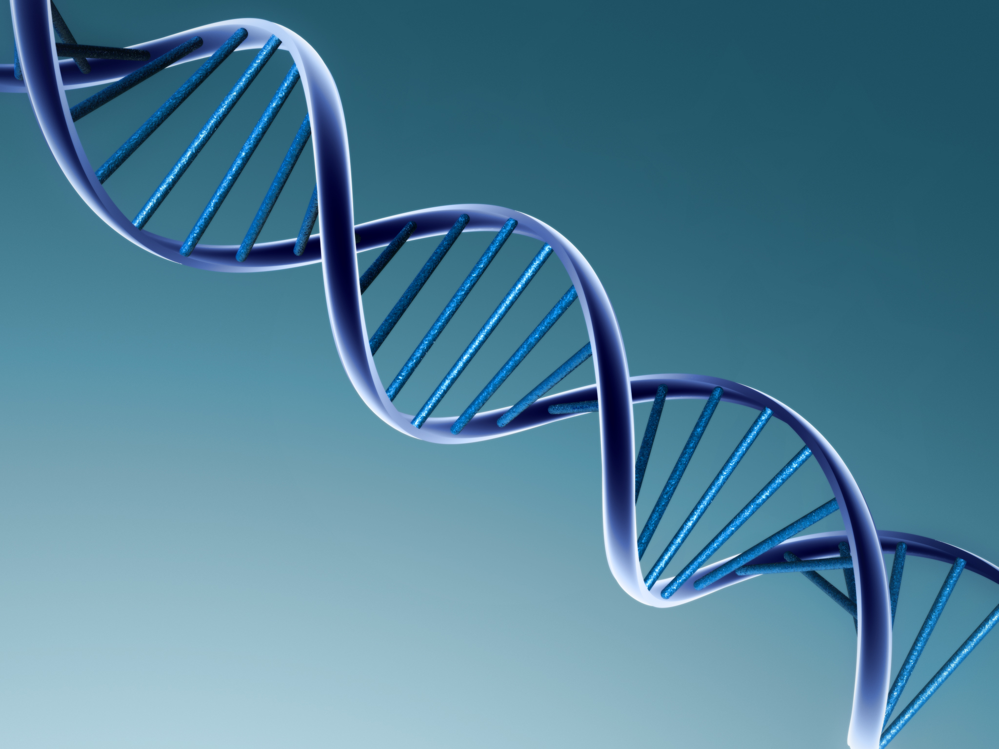

Slide 11
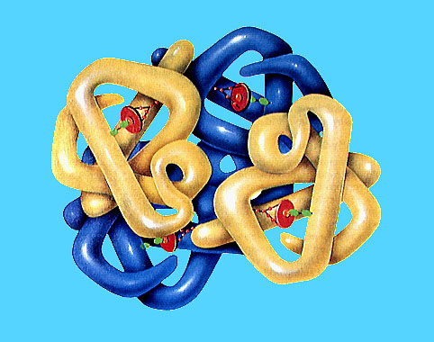
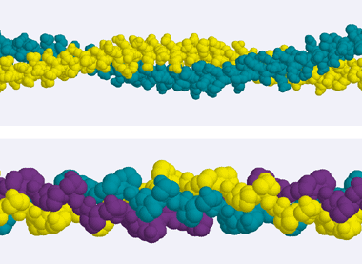
Proteins have 20 different building blocks (amino acids)
Proteins…they are much more versatile and variable. Their sizes and shapes can vary tremendously.
Long narrow, fibrous protein
Blob-shaped –globular protein

Slide 12
RNA
RNA, as you might guess, is somewhat intermediate to DNA and protein in versatility. Although only 4 different nucleotides are used to build RNA, RNA does not form a standard double helix. RNA exists as a single strand, with the ability to form sections of double strands.
Thus, the sequence of nucleotides affects the overall shape of the RNA molecule.

Slide 13
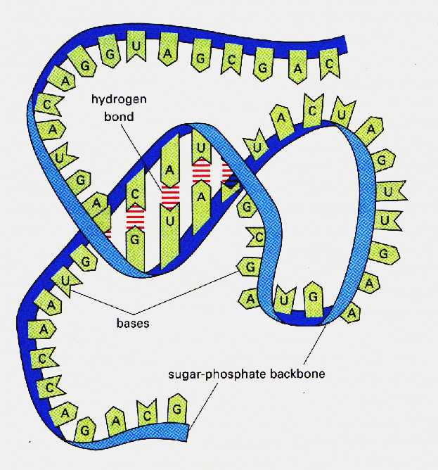
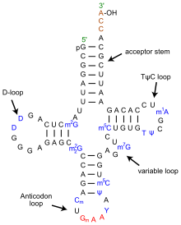
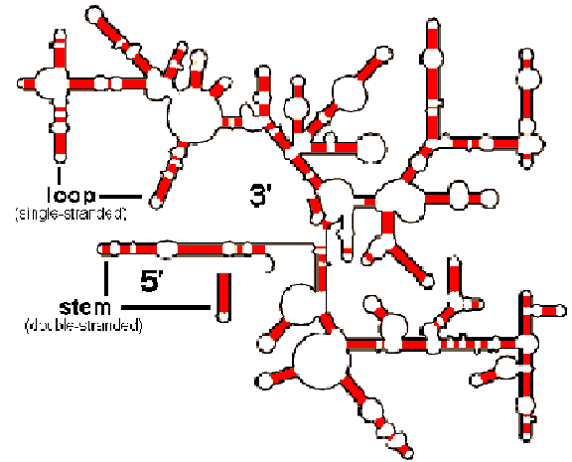

Slide 14
Form dictates function!
A key concept for this course will be that structure dictates function!
Why might it be good that DNA assumes the same shape, no matter what the sequence?
With respect to proteins, what might you guess about cells with vastly different functions?

Slide 15
Making the macromolecules
Recall, we refer to the flow of information from the recipe (DNA) to the active molecule (protein or RNA) the central dogma of molecular biology.
By definition dogma, is something that is accepted as an absolute truth.

Slide 16
Can there be exceptions…?
The “recipe” molecule can be RNA in some viruses.
Retroviruses (e.g. HIV, some of the few viruses associated with cancer)

Slide 17
Study of retroviruses led to a discovery of a new process and a new set of enzymes capable of copying RNA to DNA.
The dogma revisited….On white board.

Slide 18
Some other viruses encode their proteins directly in an RNA genome. (RNA viruses)
Rabies, Hepatitis, West Nile virus, influeza, SARS

Slide 19
Today’s dogma has led to studies that support RNA or a variation was likely life’s original genetic material.
A single strand is more likely to have assembled itself. Scientists speculate that a different, 4-carbon sugar (threose) may have been present in the nucleotides that assembled into that first nucleic acid (TNA vs. RNA)

Slide 20
http://io9.com/threose-nucleic-acid/

Slide 21
Genetic material…
What is it? What properties should it have?

Slide 22
4 crucial characteristics
Storage of information (stability and chemical code)
Replication
Retrieval of information
Variability

Slide 23
3 pivotal experiments support DNA (chpt. 10)
Griffith’s observation of transformation
Avery, MacLeod, and McCarty’s extension and biochemical analysis
Hershey and Chase’s experiement using radiolabelled molecules

Slide 24
These experiments were the first to definitively disprove the protein genetic material theory.
Why was protein such an attractive candidate?
Remember---at the time of the 3 pivotal experiments, molecular biology didn’t exist as a discipline. The closest thing was biochemistry.

Slide 25
Biochemistry involved lysing cells and analyzing the contents. 2 important findings
1. Cells have lots of protein.
2. Chromosomes, which were known to be passed from parent to offspring, have a lot of protein associated with them.

Slide 26
More support?
Scientists, naïvely thought that the genetic material would be complex and have lots of potential for variable activities.
Proteins definitely have more potential for variable shapes and functions as we’ve discussed.
Proteins were more interesting to study so nucleic acids were just largely less tested.

Slide 27
1. Fred Griffith
Coined the term transforming principle to describe the substance that conferred new traits on a strain of pneumococcal bacteria he was studying.
He provided an experimental model for recognizing a stable change in an organism and showed the transforming principle was heat stable.

Slide 29
Avery, MacLeod, and McCarty extended and improved Griffith’s assay to show that elimination of DNA, but not RNA, or protein eliminated the transformation.

Slide 30
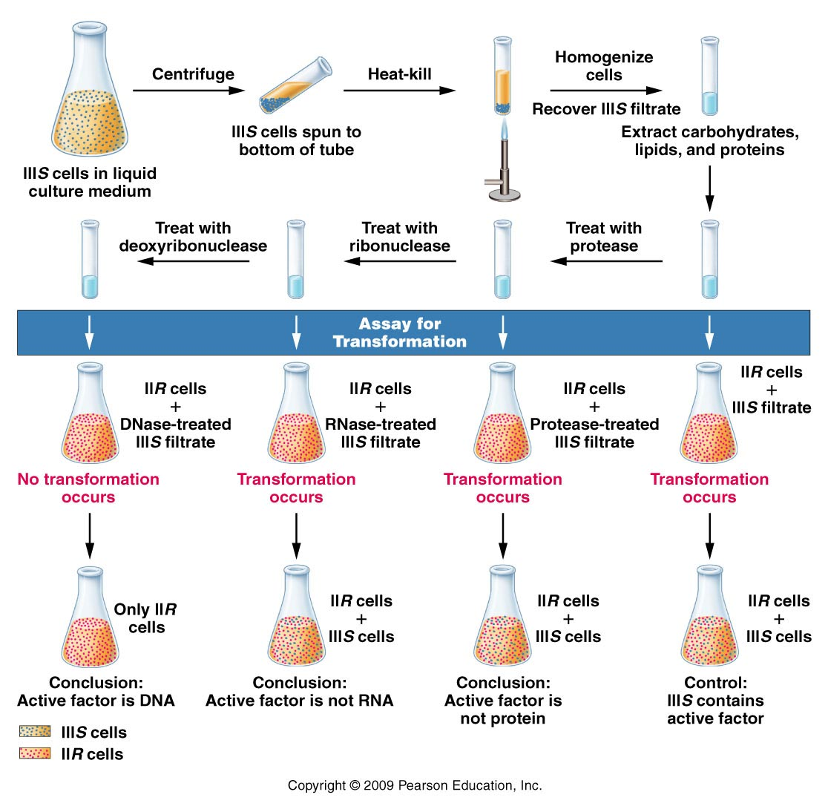
Figure 10.4
Notes:
Figure 10-4 Summary of Avery, MacLeod, and McCarty’s experiment, which demonstrated that DNA is the transforming principle.

Slide 31
Hershey and Chase
Took a different, maybe more direct approach. They asked the question, “What chemical is essential when building a new organism?”
They used viruses that infect bacteria—bacteriophages. They asked “ what chemical is used as the recipe for building new bacteriophage?”

Slide 32
Ideal system for testing a protein vs nucleic acid question.
Bacteriophages were known to have roughly 50% protein and 50% DNA with very little else in them.
The life cycle was well known and easy to use in the lab. Phage enter E. coli are produced inside the bacteria. Upon release they will consist of newly made components, but presumably will carry the recipe of the earlier generation.

Slide 33
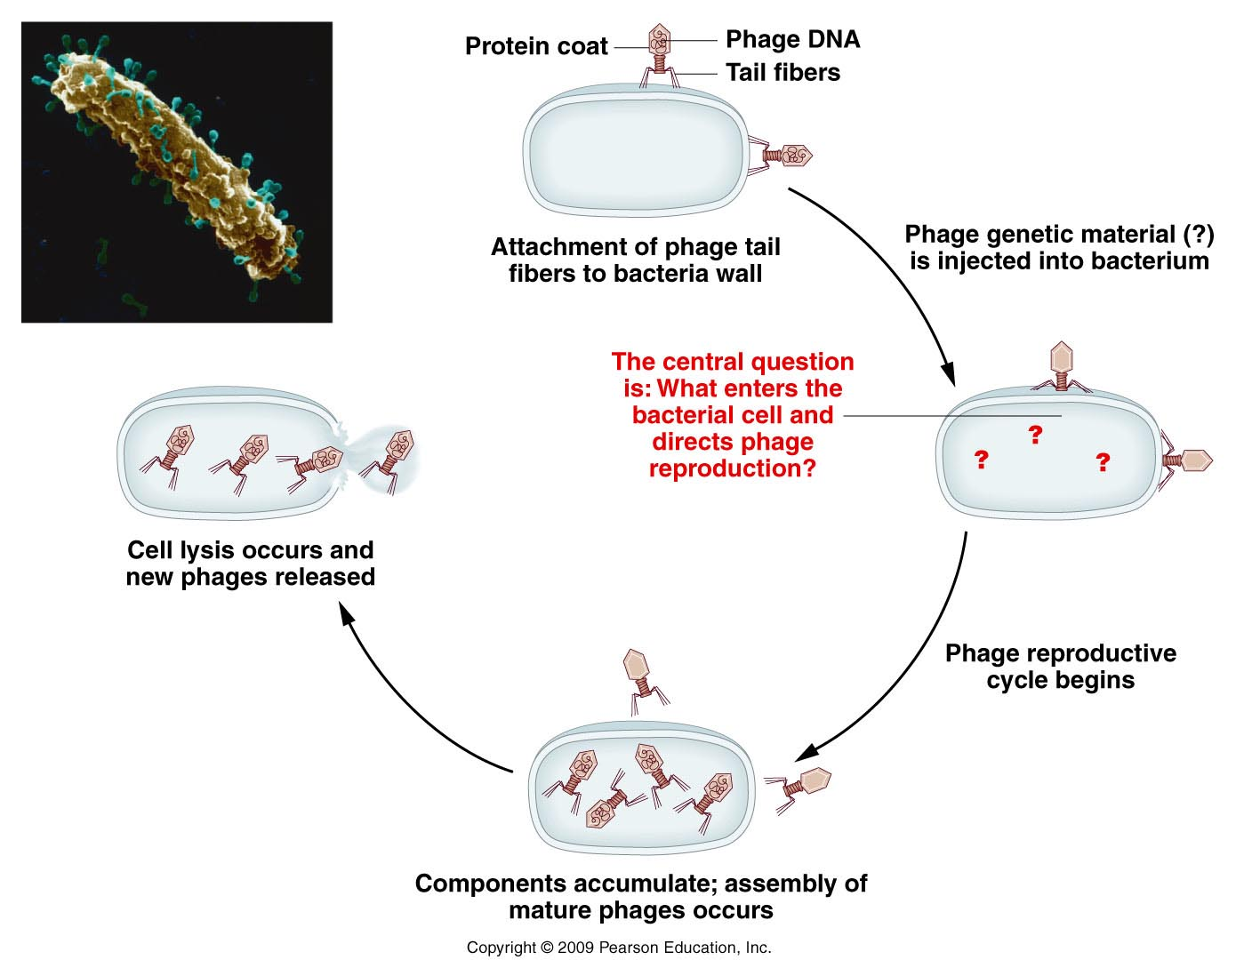
Figure 10.5
Notes:
Figure 10-5 Reproductive cycle of a T-even bacteriophage, as known in 1952. The electron micrograph shows an E. coli cell during infection by numerous phages.

Slide 34
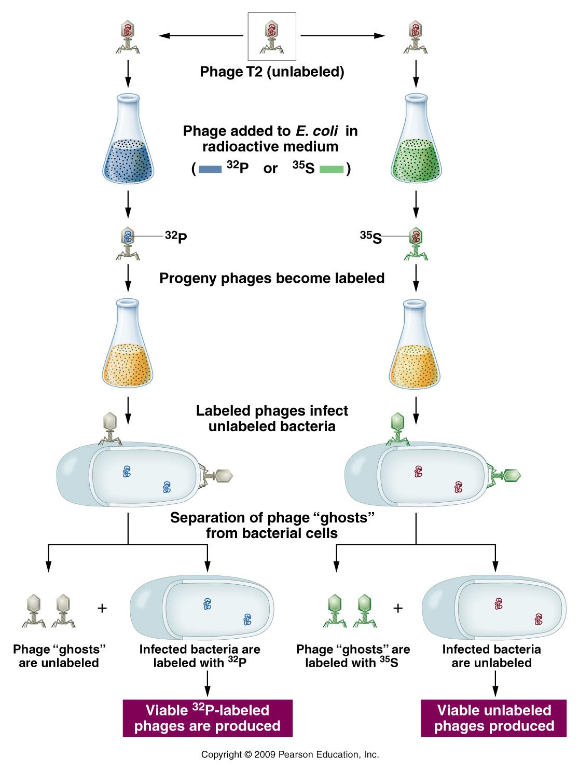
Proteins and DNA could
be uniquely labeled
with radioisotopes.
Labeled phage were
allowed to infect
bacteria.

Slide 35
Conclusion…
Even though the infecting phage incorporated either P-32 or S-35 into phage components, the “offspring” phage only contained P-32.
The molecule of heredity was p-32 labeled DNA, not protein.
The new generation of phage made new proteins (that were not radioactive) as directed by the recipe.

Slide 36
DNA as a molecule
First we have to know the building blocks
Let’s review some nucleic acid biochemistry.
Each nucleic acid is the monomer in the larger polymer

Slide 37
Nucleotides serve various fuctions
Nucleic acid building blocks* (our focus here)
Energy molecules (ATP/GTP)
Signaling molecules (cAMP)

Slide 38
Nucleotides…
3 components
5-carbon (pentose) sugar
Nitrogenous base
PO₄ group(s)
1 PO₄ group =nucleoside monophosphate
2 PO₄ groups =nucleoside diphosphate
3 PO₄ groups =nucleoside triphosphate
Nucleoside

Slide 39
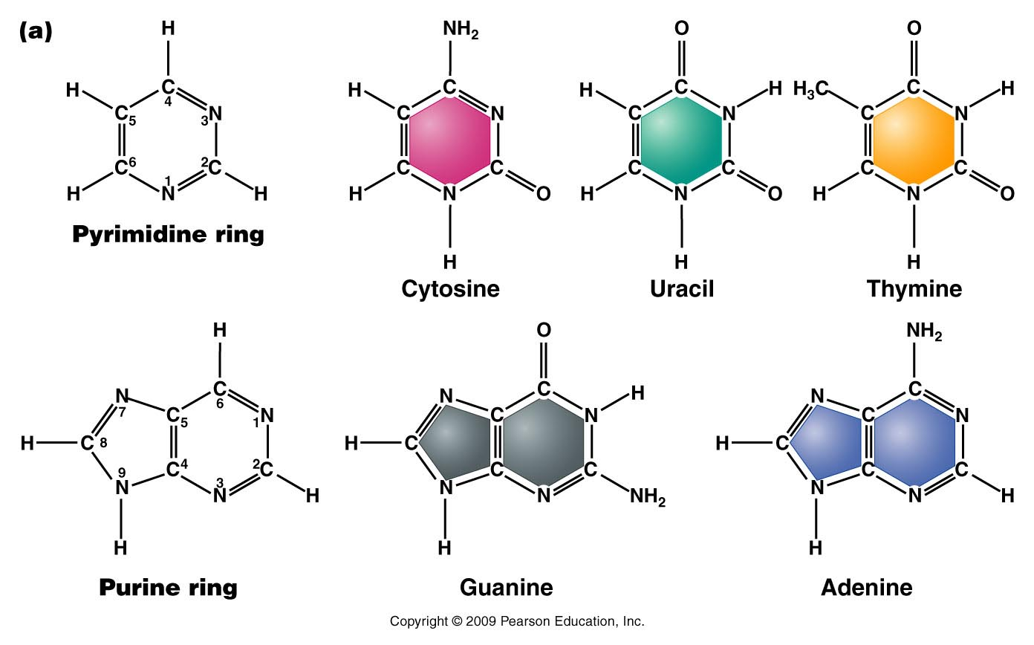
The bases---Do not memorize atomic structure but recognize pyrimidine vs. purine—note numbering of atoms.
Figure 10.9a
Notes:
Figure 10-9a (a) Chemical structures of the pyrimidines and purines that serve as the nitrogenous bases in RNA and DNA. The nomenclature for numbering carbon and nitrogen atoms making up the two bases is shown within the structures that appear on the left. (b) Chemical ring structures of ribose and 2-deoxyribose, which serve as the pentose sugars in RNA and DNA, respectively.Web Tutorial 10.1DNA Structure

Slide 40
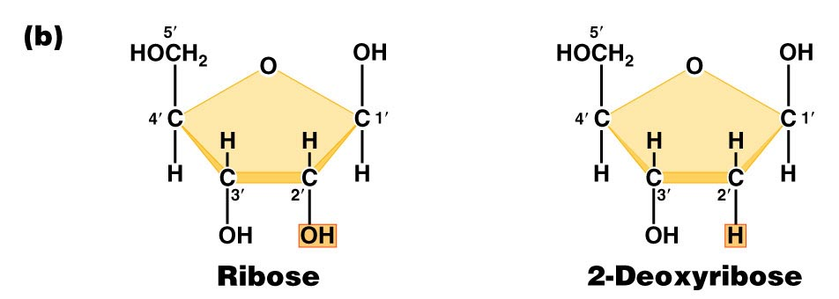
Pentose sugars in RNA and DNA
DRAW THEM!! Note the numbering of atoms (1’, 2’….carbons).
Found in RNA
Found in DNA
Figure 10.9b
Notes:
Figure 10-9b (a) Chemical structures of the pyrimidines and purines that serve as the nitrogenous bases in RNA and DNA. The nomenclature for numbering carbon and nitrogen atoms making up the two bases is shown within the structures that appear on the left. (b) Chemical ring structures of ribose and 2-deoxyribose, which serve as the pentose sugars in RNA and DNA, respectively.Web Tutorial 10.1DNA Structure

Slide 41
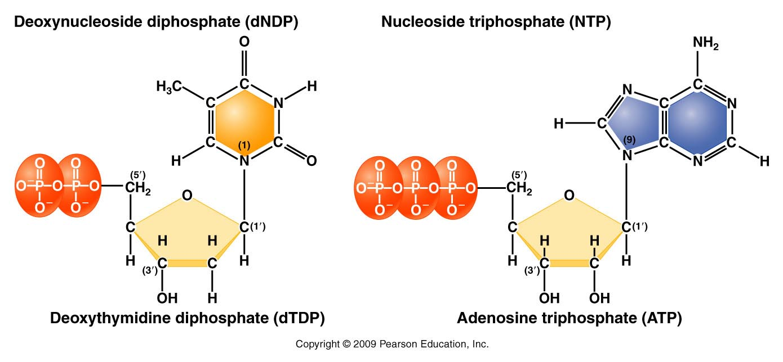
Complete structure of nucleotides
Base forms bond with the 1’ carbon of the sugar
Phosphate forms bond with the 5’carbon of the sugar
d=deoxyribose
no “d”= ribose
Figure 10.11
Notes:
Figure 10-11 Basic structures of nucleoside diphosphates and triphosphates, as illustrated by deoxythymidine diphosphate and deoxyadenosine triphosphate

